Slide 1

The Great Debate - The Future of SRM
UNIT 12 Seminar
Course: PGDip Cybersecurity
Module: Security and Risk Management July 2025 B

Slide 2

Notes:
Imaging you are a pilot flying your airplane here. Then a message comes in from air traffic control, telling you their systems are down following a ransomware attack. They’ve lost visibility of all of these aircraft on their screens.

Slide 3

Notes:
And here’s a scene we’ve seen repeatedly on the news lately:
Flights cancelled, passengers stranded, check-in desks frozen.
A cyberattack has shut down airport systems.
These kinds of disruptions were once unthinkable. But the scale and sophistication of cyberattacks today are forcing entire industries to completely rethink how to manage risk.
.

Slide 4
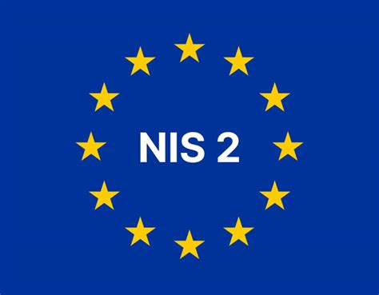

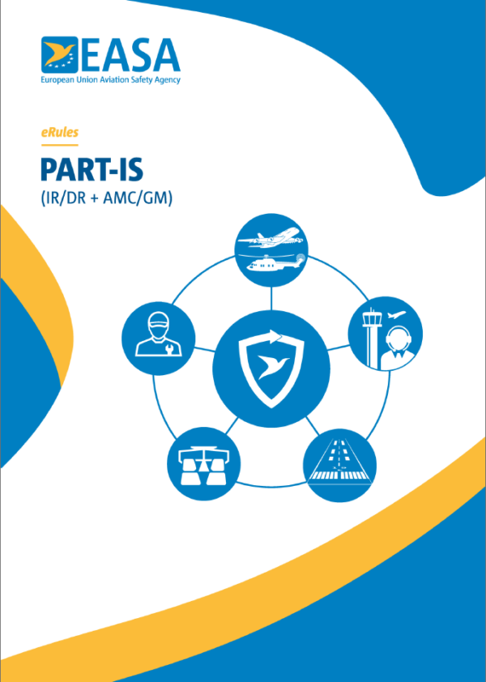
REGULATORY DRIVERS ACCELERATING TOP MANAGEMENT ACCOUNTABILITY FOR SRM
NIS2: Requires senior management to approve and oversee cybersecurity
policies, and makes them directly liable for failures.
GDPR: Places responsibility on executives for data protection and introduces
personal liability for non-compliance.
PART-IS: Aviation regulation making senior management accountable for
information security risk and their influence on aviation safety
Notes:
And with them also did the regulators. In response to these attacks, over the last few years, we have seen a clear shift in regulations moving accountability, and with it, liability for cyber risk upward. It is no longer just an operational issue; it is now a matter for senior leadership and the boardroom, demanding executive oversight, cross-departmental coordination, and governance integration (Makhanya, 2024)

Slide 5
MOST INFLUENCIAL TREND IN SRM IN THE NEXT FIVE YEARS:
RISK MANAGEMENT AS A
TOP MANAGEMENT ACCOUNTABLITY
Notes:
And that is why I believe the most influential trend in risk management over the next five years is this:
RISK MANAGEMENT AS TOP MANAGEMENT RESPONSIBILITY
In other words, risk management is no longer just a IT concern.
It is becoming a leadership issue.

Slide 6
BENEFITS OF RISK MANAGEMENT AS TOP MANAGEMENT ACCOUNTABILITY
Drives innovation in tools, methodologies, and techniques as executives and boards demand high-quality, real-time data for decision-making, such as predictive analytics, AI, and machine learning (Lopez, 2025).
Aligns SRM with business strategy and organisational goals, strengthening enterprise risk management (ERM) integration (Chaput, 2024).
Enhances organisational culture and awareness, as leadership models responsible security behaviour from the top down.
Creates business value through improved resilience, stakeholder trust, and competitive advantage (Chaput, 2024).
Notes:
When SRM becomes a board-level responsibility, executives and board members start demanding real-time, high-quality data to make informed decisions. This naturally drives investment in better tools, methodologies, and techniques, including predictive analytics and AI or machine learning systems.
It also ensures that risk management aligns directly with business strategy and goals, supporting enterprise risk management
Socially, it helps to create a culture of awareness for SRM throughout the organisation, as executives set the tone from the top.
Finally, this approach creates measurable business value by enhancing resilience and long-term trust.

Slide 7
CHALLENGES OF RISK MANAGEMENT AS TOP MANAGEMENT ACCOUNTABILITY
Technical complexity: May overwhelm some executives who are unfamiliar with the depth of cybersecurity and SRM processes.
Communication gap between technical experts and leadership: Can hinder effective understanding and prioritisation of risk.
Notes:
This shift also comes with challenges.
The first is technical complexity. Many executives are not yet familiar with the depth of cybersecurity and SRM processes, which can be overwhelming. It means organisations must invest in new skills and training at the board level to help leaders interpret technical data and make informed decisions.
The second challenge is communication. The gap between technical experts and leadership can make it difficult to prioritise risks or translate complex findings into actionable business strategy. Addressing this gap will be essential for successful board-level accountability in SRM

Slide 8

CONCLUSION – THE FUTURE OF SRM
Future SRM will depend on leadership-driven, data-informed governance.
Like a pilot using real-time instruments to navigate risk, executives will rely on AI and predictive analytics to guide strategic decisions and enhance resilience.
Notes:
This image of a cockpit captures how I see the future of SRM. The captain represents the executive or board member—responsible for steering the organisation safely through uncertainty. Just as a pilot relies on real-time flight data, leaders will depend on predictive analytics and AI-driven dashboards to understand their organisation’s risk position and make informed, timely decisions.
In short, the future of SRM will be leadership-driven and data-informed, integrating governance, technology, and strategy to strengthen resilience.”

Slide 9
References
Chaput, B. (2024) Enterprise Cyber Risk Management as a Value Creator: Leverage Cybersecurity for Competitive Advantage. 1st ed. 2024. Berkeley, CA: Apress.
Makhanya, M.T.B. (2024) ‘The implications for risk management in the era of technological advancements’. In: The Future of Risk Management. London: IntechOpen. Available at: https://www.doi.org/10.5772/intechopen.1003899 (Accessed 17 Oct. 2025).
‌Lopez, J. (2025) ‘What Are Future Trends in Risk Management?’, Entrepreneur. Available at: https://www.entrepreneur.com/building-a-business/what-are-future-trends-in-risk-managemen (Accessed 15 Oct. 2025].

